Slide 1
Unit 7
Sequence Control

Slide 2
Introduction
Sequence control is the control of the order of execution of the operations both primitive and user defined.
Sequence-control structures may be conveniently categorized into four groups:
Expressions. Properties such as precedence and associativity rules and parentheses determine how expressions become evaluated.
Statements. Statements or groups of statements, such as conditional and iteration statements, determine how control flows from one segment of a program to another.
Declarative programming. An execution model that does not depend on the order of statements in the source program.
Subprograms. Transfer control from one segment of a program to another.

Slide 3
Introduction
Sequence-control structures may be either implicit or explicit.
Implicit sequence-control structures are those defined by the language to be in effect unless modified by the programmer through some explicit structure. For example, physical sequence of statements in a program control the sequence in which statements are executed, unless modified by an explicit sequence-control statement. Language defined hierarchy of operations controls the order of execution of operations in the expression when parentheses are absent.
Explicit sequence-control structures are those that the programmer may optionally use to modify the implicit sequence of operations defined by the language. For example, Using parentheses within expressions, and conditional and iteration statements.

Slide 4
Sequencing with Arithmetic Expressions
The sequence-control mechanism determines the order of operations within the expression.
Precedence (or Hierarchy) and Associativity
In a parenthesized expression the main operation is clearly indicated.
However, we may have expressions without parentheses. In such cases, we need to know: operator's precedence and operator's associativity.
Precedence concerns the order of applying operations and associativity deals with the order of operations of same precedence.
Precedence and associativity are defined when the language is defined within the semantic rules for expressions.

Slide 5
Sequencing with Arithmetic Expressions
Tree Structure Representation:
An arithmetic expression can be represented in the form of an expression tree.
The basic sequence-control mechanism in expressions is functional composition:
An operation and its operands are specified
The operands may be either constants, data objects, or other operations, whose operands in tern may be constants, data objects, or still other operations
Functional composition gives an expression the characteristic structure of a tree, where the root node of the tree represents main operation, nodes between the root and the leaves represent intermediate-level operation, and the leaves represent data references (or constants).

Slide 6
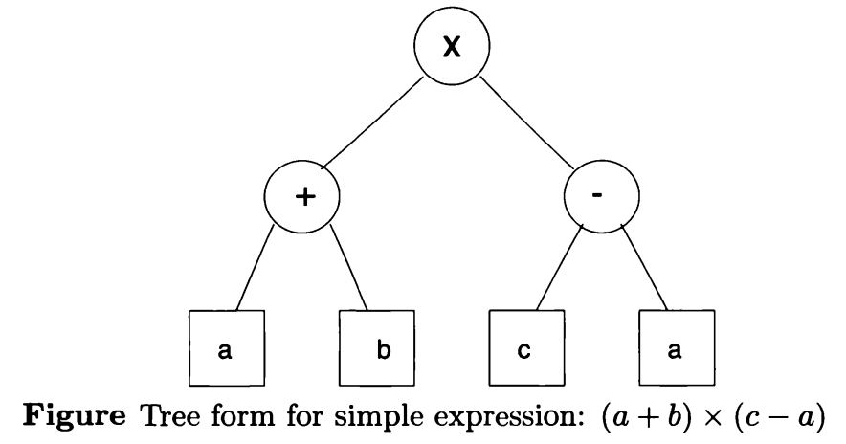
Sequencing with Arithmetic Expressions
The tree representation clarifies the control structure of the expression. Clearly the results of data references or operations at lower levels in the tree serve as operands for operations at higher levels in the tree, and thus these data references and operations must be evaluated (executed) first..

Slide 7
Sequencing with Arithmetic Expressions
Syntax for Expressions:
Prefix (Polish prefix) notation. Named after polish mathematician Jan Lukasiewicz, refers to notation in which operator symbol is placed before its operands. For example, *XY, -AB, /*ab-cd
Cambridge Polish – variant of notation used in LISP, parentheses surround an operator and its arguments. For example, (/(*ab)(-cd))
Postfix or reverse polish. Postfix refers to notation in which the operator symbol is placed after its two operands. For example, AB*, XY-
Infix notation. It is most suitable for binary (dyadic) operation. The operator symbol is placed between the two operands.

Slide 8
Sequencing with Arithmetic Expressions
Semantics for Expressions:
Semantics determine the order of expression in which they are evaluated.
Evaluation of Prefix Expression. If P is an expression evaluate using stack
If the next item in P is an operator, push it on the stack. set the arguments count to be number of operands needed by operator. (if number is n, operator is n-ary operator)
If the next item in P is an operand, push it on the stack
If the top n entries in the stack are operand entries needed for the last n-ary operator on the stack, apply the operator on those operands. Replace the operator and its n operands by the result of applying that operation on the n operands.

Slide 9
Sequencing with Arithmetic Expressions
Evaluation of Postfix Expression. If P is an expression evaluate using stack
If the next item in P is an operand, push it on the stack.
If the next item in P is an n-ary operator, its n arguments must be top n items on the stack. Replace these n items by the result of applying this operation using the n items as arguments.
Evaluation of Infix Expression. Infix notation is common but its use in expression cause the problems:
Infix notation is suitable only for binary operations. A language cannot use only infix notation but must combine infix and postfix (or prefix) notations. The mixture makes translation complex.
If more than one infix operator is in an expression, the notation is ambiguous unless parentheses are used.

Slide 10
Sequencing with Arithmetic Expressions
Execution-Time Representation:
Machine code sequences. The expression is translated into actual machine code. The ordering of the instructions reflects the sequence-control structure of the original expression.
Tree structures. Expressions may be executed directly in their natural tree structure representation using software interpreter
Prefix or postfix form. Expressions in prefix or postfix form may be executed by the simple interpretation algorithm.

Slide 11
Sequencing with Arithmetic Expressions
Evaluation of Tree Representation of Expressions: Problems of order of evaluation in determining exactly the code to generate.
Problem 1. Uniform evaluation rules. For each operation node in the expression tree, first evaluate (or generate code to evaluate) each of its operands and then apply the operation (or generate code to apply operation) to the evaluated operands. This is called eager evaluation rule because we always evaluate operands first.
In lazy evaluation rule, never evaluate operands before applying the operation. Pass the operands unevaluated and let the operation decide if evaluation is needed. It is impractical to implement in many cases as it requires substantial software simulation.

Slide 12
Sequencing with Arithmetic Expressions
Problem 2. Side effects. The use of operations may have side effects in expressions. Consider the expression
c / func(y) + c
r-value of c must be fetched and func(y) must be evaluated before division. If fun(y) has the side effect of modifying the value of c, the order of evaluation is critical.
Problem 3. Error conditions. Error conditions may arise in many primitive operations (overflow, divide by zero).
Problem 4. Short-circuit Boolean expressions. It is often natural to use Boolean operations AND and OR to combine relational expressions. For example, consider the statements
if ((X == 0) || ( Y/X < Z) {……..}
and
do {……} while (( I > UB) && (A[I] < B))

Slide 13
Sequencing with Arithmetic Expressions
Evaluation of second operand of Boolean expression may lead to an error condition (division by zero, subscript range error).
In C, the left expression is evaluated first and second expression is evaluated only when needed.
In many languages, both operands are evaluated before Boolean expression is evaluated.
Many programming errors arise from the expectation that the value of the left operand of a Boolean operation may short-circuit the rest of the evaluation if the value of the overall expression may be decided from the value of the left operand alone.
ADA includes two special Boolean operations and then , or else
if ( X = 0) or else (Y/X > Z) then……. can’t fail because of division by zero.

Slide 14
Sequencing Control Between Statements
The sequence in which the individual statements are executed within a program.
Basic Statements
Assignment statement – Assign to the l-value of a data object (memory location) the r-value (data object value) of some expression.
Subprogram calls – Assignment of the argument value to the formal parameter.
Input statement – Change the value of variables through assignments
Output statement – Assignment to the buffer variable of a file.

Slide 15
Sequencing Control Between Statements
Forms of Statement-Level Sequence Control
Composition – Statements may be placed in a textual sequence so that they are executed in order whenever the larger program structure containing the sequence is executed.
Alternation – Two sequences of statements may form alternatives so that one or the other sequence is executed, but not both, whenever the larger program structure containing both sequences is executed.
Iteration – A sequence of statements may ne executed repeatedly, zero or more times (zero meaning execution may be omitted altogether), whenever the larger program structure containing the sequence is executed.

Slide 16
Sequencing Control Between Statements
Explicit Sequence Control
The transfer of control is most often indicated by use of a goto statement to an explicit statement with a given label name. Two forms of goto statement are often present in many languages: unconditional goto (such as, goto NEXT) and conditional goto (such as, if A = 0 then goto NEXT). The use of goto has been the target of much criticism. Use of goto statements leads to an unstructured design of a program.
Some languages include a break statement as a form of structured explicit control. Some languages also include continue statement. The break will exit a loop, whereas the continue will iterate the loop again. The break in C language also causes control to exit the immediately enclosing switch statement.

Slide 17
Sequencing Control Between Statements
Structured Sequence Control
Most languages provide a set of control statements for expressing the basic control forms of composition, alteration, and iteration.
Compound Statements – A compound statement is a sequence of statements that may be treated as s single statement in the construction of larger statements. Within the compound statement, statements are written in the order in which they are to be executed. Thus, the compound statement is the basic structure for representing the composition of statements.
Conditional Statements – A conditional statement is one that expresses alteration of two or more statements, or optional execution of a single statement, where statement means either a single basic statement, a compound statement, or another control statement. The choice of alternative is controlled by a test on some condition, usually written as an expression involving relational and Boolean operations. The most common forms of conditional statement are the if and case statements. Implemented using hardware supported branch and jump instructions.

Slide 18
Sequencing Control Between Statements
Iteration Statements – These statements provide the basic mechanism for repeated calculations. The basic structure consists of a head and a body. The head controls the number of times that the body will be executed, whereas the body is usually a (compound) statement that provides the action of the statement. Most languages have for, foreach, while, and do-while statements for iteration. Implemented using hardware branch/jump instructions.

